Slide 1


Unit 6: Exception Handling, Applet, File Handling
SE E&CE

Slide 2
File Handling
In Java, file handling is done with File Class.
The File Class is inside the java.io package. The File class can be used by creating an object of the class and then specifying the name of the file.
File Handling is an integral part of any programming language as file handling enables us to store the output of any program in a file and allows us to perform certain operations on it.
In simple words, file handling means reading and writing data to a file.

Slide 3
Streams in Java
In Java, a sequence of data is known as a stream.
This concept is used to perform I/O operations on a file.
There are two types of streams :
Input Stream
Output Stream

Slide 4
Input Stream
The Java InputStream class is the superclass of all input streams.
The input stream is used to read data from numerous input devices like the keyboard, network, etc.
InputStream is an abstract class, its subclasses are used to read data.
There are several subclasses of the InputStream class, which are:
AudioInputStream
ByteArrayInputStream
FileInputStream
FilterInputStream
StringBufferInputStream
ObjectInputStream

Slide 5
Creating an InputStream
InputStream obj = new FileInputStream();
We can create an input stream from other subclasses as well as InputStream.

Slide 6
Methods of InputStream
Method | Description
read() | Reads one byte of data from the input stream.
read(byte[] array)() | Reads byte from the stream and stores that byte in the specified array.
mark() | It marks the position in the input stream until the data has been read.
available() | Returns the number of bytes available in the input stream.
markSupported() | It checks if the mark() method and the reset() method is supported in the stream.
reset() | Returns the control to the point where the mark was set inside the stream.
skips() | Skips and removes a particular number of bytes from the input stream.
close() | Closes the input stream.

Slide 7
Output Stream
The output stream is used to write data to numerous output devices like the monitor, file, etc.
OutputStream is an abstract superclass that represents an output stream.
OutputStream is an abstract class, its subclasses are used to write data.
There are several subclasses of the OutputStream class:
ByteArrayOutputStream
FileOutputStream
StringBufferOutputStream
ObjectOutputStream
DataOutputStream
PrintStream

Slide 8
Creating an OutputStream
OutputStream obj = new FileOutputStream();
We can create an output stream from other subclasses as well as OutputStream.

Slide 9
Methods of OutputStream
Method | Description
write() | Writes the specified byte to the output stream.
write(byte[] array) | Writes the bytes which are inside a specific array to the output stream.
close() | Closes the output stream.
flush() | Forces to write all the data present in an output stream to the destination.

Slide 10
Byte Streams
This streams is used to read or write byte data. The byte stream is again subdivided into two types which are as follows:
Byte Input Streams: Used to read byte data from different devices.
Byte Output Streams: Used to write byte data to different devices.
Examples:
FileInputStream → Reads data from a file
. FileOutputStream → Writes data to a file.

Slide 11
Character Stream
This stream is used to read or write character data. Character stream is again subdivided into 2 types which are as follows:
Character Input Stream: Used to read character data from different devices.
Character Output Stream: Used to write character data to different devices.
Examples:
FileReader → Reads characters from a file.
FileWriter → Writes characters to a file.

Slide 12
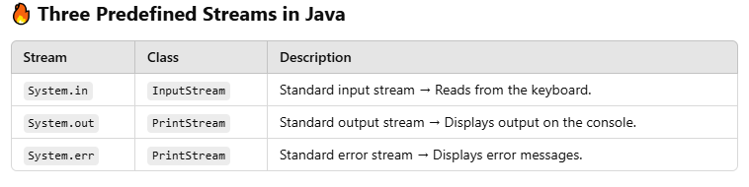


Predefined Streams in JAVA

Slide 13
public class SystemOutExample {
public static void main(String[] args) {
System.out.print("Hello, "); // Prints on the same line
System.out.println("World!"); // Prints with newline
System.out.printf("Value of PI: %.2f", Math.PI); // Formatted output
}
}
import java.util.Scanner;
public class SystemInExample {
public static void main(String[] args) {
Scanner scanner = new Scanner(System.in);
System.out.print("Enter your name: ");
String name = scanner.nextLine();
System.out.println("Hello, " + name + "!");
scanner.close();
}
}

Slide 14
public class SystemErrExample {
public static void main(String[] args) {
System.out.println("Normal output...");
try {
int result = 10 / 0; // Division by zero → Exception
} catch (ArithmeticException e) {
System.err.println("Error: Division by zero!"); // Print error
}
}
}

Slide 15
The PrintWriter class in Java, part of the java.io package, is used for writing formatted data to files or console.
It offers more functionality compared to FileWriter and BufferedWriter, including:
Automatic flushing with constructors.
Formatted output (similar to System.out.printf()).
Supports writing both character and byte data.
Can write to files, console, and even network sockets.

Slide 16
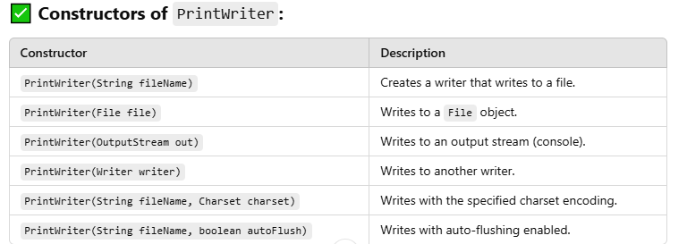


Slide 17
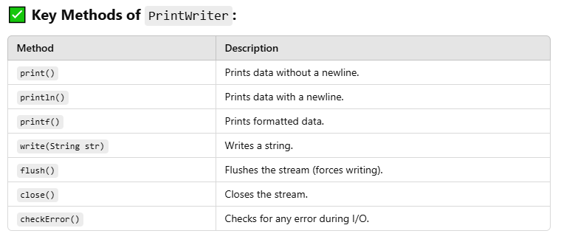


Slide 18
Java File Class Methods
Method Name | Description | Return Type
canRead() | It tests whether the file is readable or not. | Boolean
canWrite() | It tests whether the file is writable or not. | Boolean
createNewFile() | It creates an empty file. | Boolean
delete() | It deletes a file. | Boolean
exists() | It tests whether the file exists or not. | Boolean
length() | Returns the size of the file in bytes. | Long
getName() | Returns the name of the file. | String
list() | Returns an array of the files in the directory. | String[]
mkdir() | Creates a new directory. | Boolean
getAbsolutePath() | Returns the absolute pathname of the file. | String

Slide 19
File Operations in Java
The following are the several operations that can be performed on a file in Java :
Create a File
Read from a File
Write to a File
Delete a File

Slide 20
Create a File
In order to create a file in Java, the createNewFile() method can be used.
If the file is successfully created, it will return a Boolean value true and false if the file already exists.

Slide 21
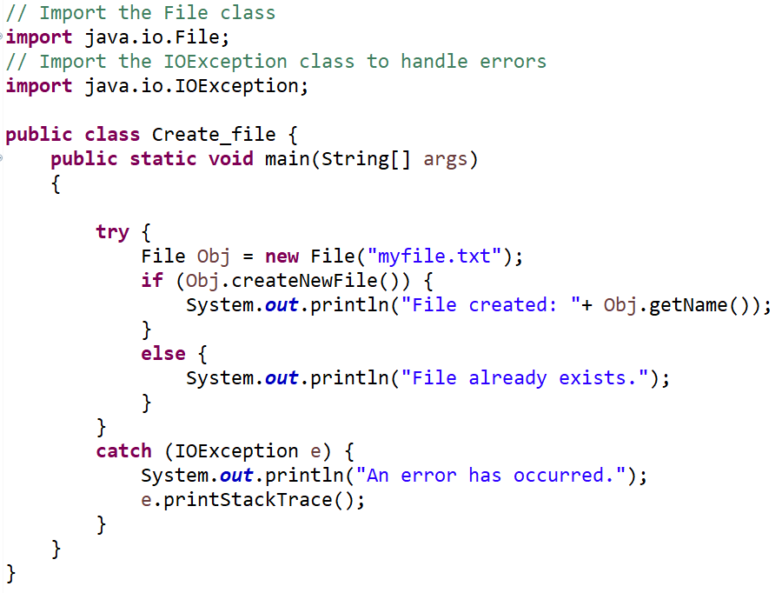

Slide 22
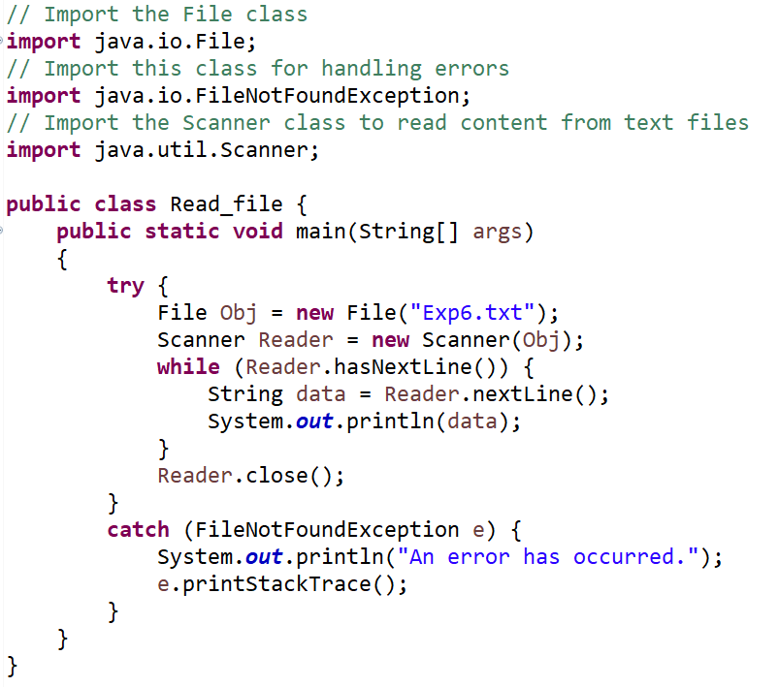
Read from a File

Slide 23
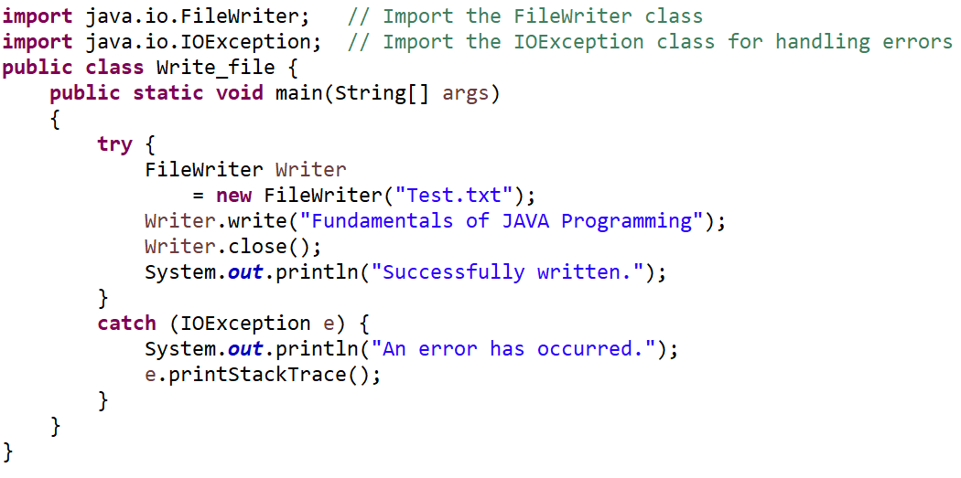
Write to a File
Use of FileWriter class along with its write() method in order to write some text to the file.

Slide 24
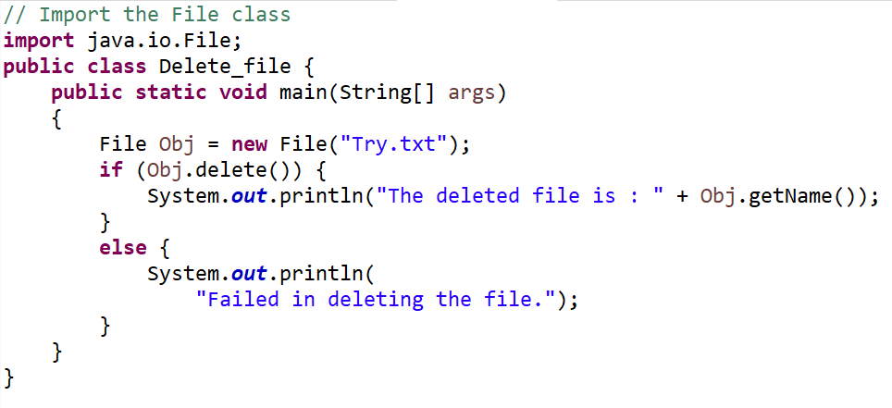
Delete a File
Use of delete() method in order to delete a file

Slide 25
Random Access Files in Java
The class RandomAccessFile is used for reading and writing to random access file.
A random-access file behaves like a large array of bytes.
There is a cursor implied to the array called file pointer, by moving the cursor to read write operations.
If end-of-file is reached before the desired number of byte has been read than EOFException is thrown.
It is a type of IOException.

Slide 26
Constructor
Constructor | Description
RandomAccessFile (File file, String mode) | Creates a random access file stream to read from, and optionally to write to, the file specified by the File argument.
RandomAccessFile (String name, String mode) | Creates a random access file stream to read from, and optionally to write to, a file with the specified name.

Slide 27
Methods
Modifier and Type | Method | Method
void | close() | It closes this random access file stream and releases any system resources associated with the stream.
FileChannel | getChannel() | It returns the unique FileChannel object associated with this file.
int | readInt() | It reads a signed 32-bit integer from this file.
String | readUTF() | It reads in a string from this file.
void | seek(long pos) | It sets the file-pointer offset, measured from the beginning of this file, at which the next read or write occurs.
void | writeDouble (double v) | It converts the double argument to a long using the doubleToLongBits method in class Double, and then writes that long value to the file as an eight-byte quantity, high byte first.
void | writeFloat(float v) | It converts the float argument to an int using the floatToIntBits method in class Float, and then writes that int value to the file as a four-byte quantity, high byte first.
void | write(int b) | It writes the specified byte to this file.
int | read() | It reads a byte of data from this file.
long | length() | It returns the length of this file.
void | seek(long pos) | It sets the file-pointer offset, measured from the beginning of this file, at which the next read or write occurs.

Slide 28
References
E Balagurusamy, “Programming with JAVA”, Tata McGraw Hill, 6th Edition.
Herbert Schildt, “Java: The complete reference”, Tata McGraw Hill, 7th Edition.
https://www.tutorialspoint.com
https://www.geeksforgeeks.org
https://www.javatpoint.com/
Online Resources

